Slide 1
App Development
Android/Flutter/Flask

Slide 2
Android
Android is a software stack for mobile devices that includes an operating system, middleware and key applications.
Android was developed by the Open Handset Alliance, led by Google, and other companies.

Slide 3
Android application
An android app is a software application running on the android platform. Because the android platform is built for mobile devices, a typical android app is designed for a smart phone, or a tablet PC running on the android OS.

Slide 4
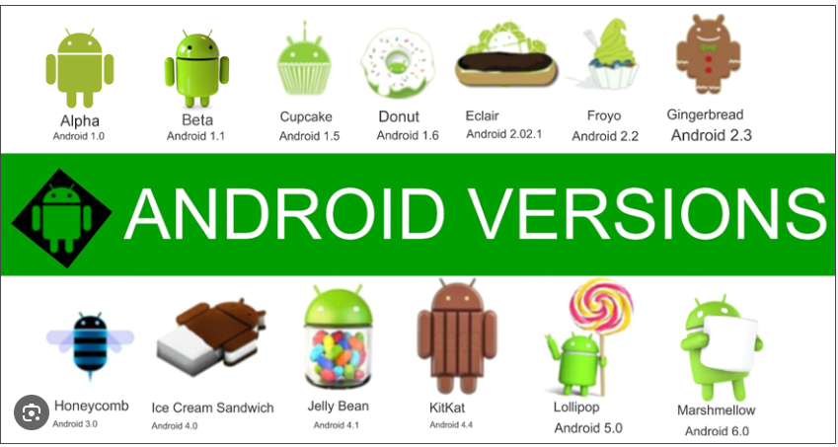
Versions of Android

Slide 5
Pre-requisites
Android programming is based on Java programming language so if you have basic understanding on Java programming then it will be a fun to learn Android application development.
OOPS concepts like class, objects, interface, inheritance, overriding etc.
Basics of any mark-up language like HTML or XML.

Slide 6
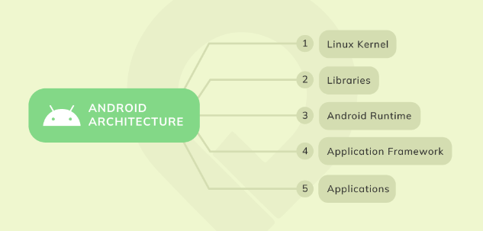
Android Architecture
This provides a level of abstraction between the device hardware and it contains all the essential hardware drivers like camera, keypad, display etc.
There is a set of libraries including open-source Web browser engine WebKit, well known library libc.
Dalvik Virtual Machine which is a kind of Java Virtual Machine specially designed and optimized for Android.
The Application Framework layer provides many higher-level services to applications in the form of Java classes.
All the applications are installed on this layer only. Examples of such applications are Contacts Books, Browser, Games etc.

Slide 7
Application Components
Application components are the essential building blocks of an Android application. These components are loosely coupled by the application manifest file AndroidManifest.xml that describes each component of the application and how they interact.

Slide 8
Activities
An activity represents a single screen with a user interface,in-short Activity performs actions on the screen. For example, an email application might have one activity that shows a list of new emails, another activity to compose an email, and another activity for reading emails. If an application has more than one activity, then one of them should be marked as the activity that is presented when the application is launched.
An activity is implemented as a subclass of Activity class as follows −
public class MainActivity extends Activity {
}

Slide 9
Services
A service is a component that runs in the background to perform long-running operations. For example, a service might play music in the background while the user is in a different application, or it might fetch data over the network without blocking user interaction with an activity.
A service is implemented as a subclass of Service class as follows −
public class MyService extends Service {
}

Slide 10
Broadcast Receivers
Broadcast Receivers simply respond to broadcast messages from other applications or from the system. For example, applications can also initiate broadcasts to let other applications know that some data has been downloaded to the device and is available for them to use, so this is broadcast receiver who will intercept this communication and will initiate appropriate action.
A broadcast receiver is implemented as a subclass of BroadcastReceiver class and each message is broadcaster as an Intent object.
public class MyReceiver extends BroadcastReceiver {
public void onReceive(context,intent){
}
}

Slide 11
Content Providers
A content provider component supplies data from one application to others on request. Such requests are handled by the methods of the ContentResolver class. The data may be stored in the file system, the database or somewhere else entirely.
A content provider is implemented as a subclass of ContentProvider class and must implement a standard set of APIs that enable other applications to perform transactions.
public class MyContentProvider extends ContentProvider { public void onCreate(){
}
}

Slide 12
UI Layout
The basic building block for user interface is a View object which is created from the View class and occupies a rectangular area on the screen and is responsible for drawing and event handling. View is the base class for widgets, which are used to create interactive UI components like buttons, text fields, etc.
The ViewGroup is a subclass of View and provides invisible container that hold other Views or other ViewGroup
At third level we have different layouts which are subclasses of ViewGroup class and a typical layout defines the visual structure for an Android user interface and can be created either at run time using View/ViewGroup objects or you can declare your layout using simple XML file main_layout.xml which is located in the res/layout folder of your project.s and define their layout properties.

Slide 13
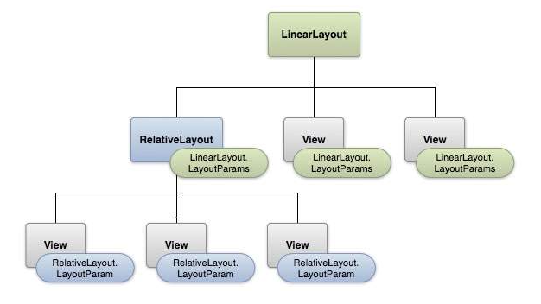
Layout Structure

Slide 14
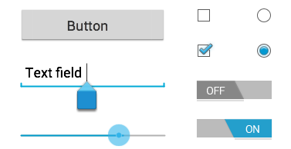
UI Controls
Input controls are the interactive components in your app's user interface. Android provides a wide variety of controls you can use in your UI, such as buttons, text fields, seek bars, check box, zoom buttons, toggle buttons, and many more.
UI Elements
A View is an object that draws something on the screen that the user can interact with and a ViewGroup is an object that holds other View (and ViewGroup) objects in order to define the layout of the user interface.

Slide 15
Conclusion
All Google services can you have with one operating system, namely “Android”. By Android versions its features are increased rapidly. So most of the users like Android smart phones, and it is best OS among all other OS like windows, iOS.
When a device goes from just working to actually making life easier, Android is behind it. It's the reason your GPS avoids traffic, your watch can text and your Assistant can answer questions. It's the operating system inside 2.5 billion active devices.

